Slide 1

TRF Completion and Lab Report Review
Presented by :- Aarti, Manasi, Dr. Geetu, Adil

Slide 2
Contents
What is TRF
Importance of TRF
Components of TRF
Lab Report Review
Categories of Common Laboratory Tests
References

Slide 3
What is TRF
The test requisition combines patient registration information, billing information, specimen information, barcoded specimen labels and a provider order for confirmation of testing.
TRF is used for requesting for medical or laboratory tests to be completed.

Slide 4
Importance of TRF
A type of agreement between patient and lab.
A consent form of patient.
Record of patient their tests and type of sample.
Helps to identify patient.

Slide 5
Components of TRF (1/6)
Patient Information
Ordering Provider
Referring laboratory
Clinical history and findings
Specimen information

Slide 6
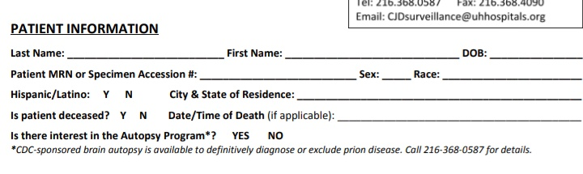
Components of TRF (2/6)
1. Patient Information:-
Patient information helps to identify patient
Patient name
Patient address
Contact no.
Age, gender,
Date of birth etc.

Slide 7
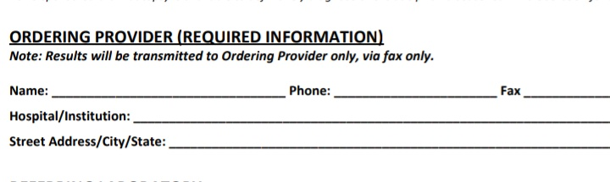
Component of TRF(3/6)
2. Ordering provider
Ordering physician complete information
Name of physician
Phone no
Fax no
Hospital/institution name
Street address/city/state

Slide 8
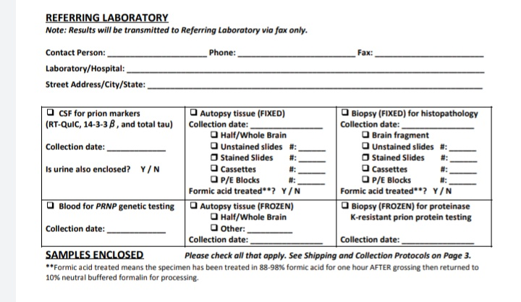
Component of TRF (4/6)
3. Referring laboratory
It helps to effectively manage the flow of sample and associated data to improve lab efficacy
Contact person
Phone, fax
Laboratory name
Street address/ city/state

Slide 9
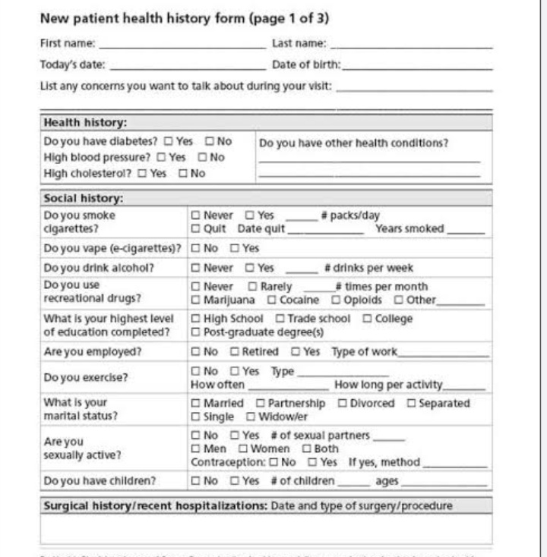
Components of TRF (5/6)
4. Clinical history and findings
It helps to arrange regular check-ups minutely assess and give best of medical facilities to the patient
Symptoms concerning from prior disease
Social and family history
Medical and surgical history

Slide 10
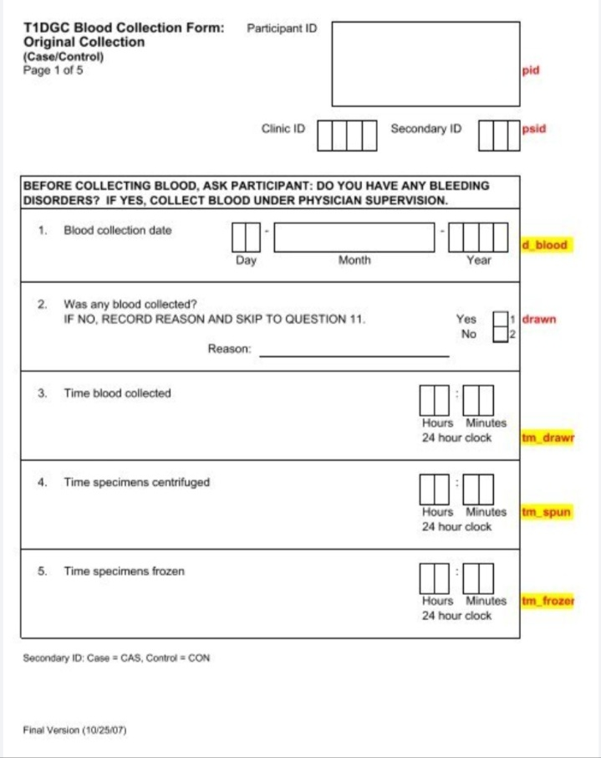
Components of TRF (6/6)
5. Specimen information:-
Specimens date of collection is important , temperature , order of specimens in serial testing, identification of source of any specimen other than blood.

Slide 11
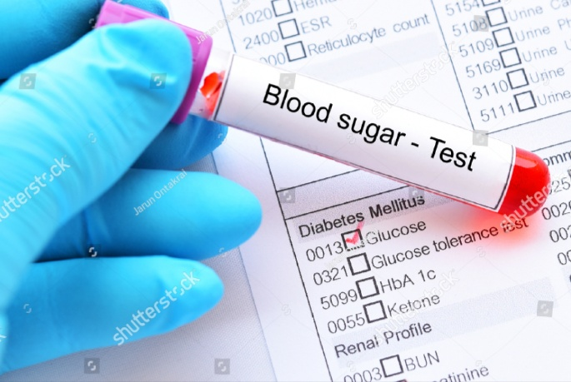
Lab Report Review
Lab reports are written to describe and analyse a laboratory experiment that explores a scientific concept.
They are typically assigned to enable you to:-
Conduct scientific research formulate a hypothesis/hypotheses about a particular stimulus, event, and /or behaviour

Slide 12
Categories of common laboratory tests(1/4)
The most common categories for laboratory tests for human clinical trials are
1. Hematology, Blood (or serum) chemistry:- The hematology category is of those tests involving the cellular components of blood, clotting sometime involved in hematology.
Common hematology laboratory test
RBC
Hemoglobin
MCV (Mean Corpuscular Volume)
MCH (Mean Corpuscular Hemoglobin)
MCHC (Mean Corpuscular Hemoglobin Concentration)

Slide 13
Categories of Common Laboratory Tests(2/4)
2. Urinalysis and coagulation :-
The urinalysis group are those tests involving components of the urine
Coagulation factor test is used to find out problem with any clotting factor that may cause too little or too much blood clotting
Common Urinalysis and Coagulation laboratory test
Urine Ph
Urine Specific Gravity
Prothrombin Time (PT)
Partial Thromboplastin Time(PTT)
International Normalization Ratio (INR)

Slide 14
Categories of Common Laboratory Tests (3/4)
Less common categories are
1. Microbiology :-
Tests those are testing for the presence of specific bacteria. and fungi
Common microbiology laboratory test
Cerebro spinal fluid culture and sensitivity
Blood culture and sensitivity
Urine culture and sensitivity

Slide 15
Categories of Common Laboratory Tests (4/4)
2. Stool specimens:-
A stool specimen analysis is a series of tests done on a stool sample to help diagnose certain conditions affecting the digestive tract.
3. Testing for specific drugs:-
Skin testing for allergic reaction

Slide 16
Points to Be Remember While Reviewing Blood Reports
Lab sample collected after signing correct version of ICF only
Assigned study staff only involving in laboratory related process
Calibration certificates of all instruments which are part of lab are up to date
All test performed as requested by protocol as per each visit
Ensure subject information reflecting in source, TRF and report is matching

Slide 17
Points to Be Remember While Reviewing Blood Reports
Ensure units of all lab tests are matching with reference ranges shared by site
Ensure tests which are important to achieve goal performed on time and as per process
All laboratory reports has been signed by PI/sub I
Clinically significant /non significant comment reflecting in reports
Ensure AE has been captured for each clinically significant lab values

Slide 18
References
https://www.mdlab.com/physicians/test-requisition-form/
ICH- GCP E6 R2

Slide 19

Thank you!

